Slide 1
Data Types in C#
By Adam Sepulveda

Slide 2
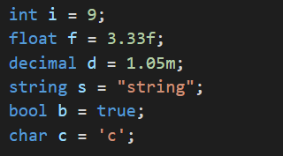
Data Types
C# is strongly typed,
Every variable must have a data type declared.
Datatypes are objects used to store different types of data temporarily
All data types are inherited from System.Object.
Ex. Int, string, float.
Types can be predefined or user defined.
The Following declares and initializes variables of different data types:

Slide 3
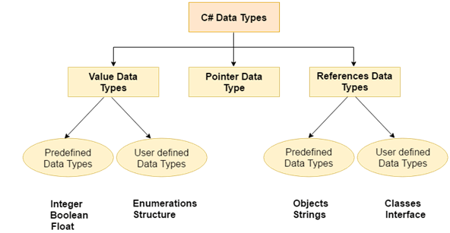
3 Types of Data Types
Value Data Type
Holds data within own memory
Integer and floating based (int, float, char, bool)
Reference Data Type
Contains reference to the data
Ex. object, string
Pointer Data Type
Uses pointer to store the memory address of a value.

Slide 4
Value Data Types
Value types are integer or floating based
C# supports both signed and unsigned literals
Type | Description | Range
Sbyte | 8-bit signed integer | -128 to 127
short | 16-bit signed integer | -32,768 to 32,767
int | 32-bit signed integer | -2,147,483,648 to 2,147,483,647
long | 64-bit signed integer | -9,223,372,036,854,775,808 to 9,223,372,036,854,775,807
byte | 8-bit unsigned integer | 0 to 255
ushort | 16-bit unsigned integer | 0 to 65,535
uint | 32-bit unsigned integer | 0 to 4,294,967,295
ulong | 64-bit unsigned integer | 0 to 18,446,744,073,709,551,615

Slide 5
Value Data Types (Cont.)
Type | Description | Range
char | 16-bit single Unicode character | Any valid character, e.g. a,*, \x0058 (hex), or\u0058 (Unicode)
bool | 8-bit logical true/false value | true or false
float | 32-bit Single-precision floating point type | -3.402823e38 to 3.402823e38
double | 64-bit double-precision floating point type | -1.79769313486232e308 to 1.79769313486232e308
decimal | 128-bit decimal type | (+ or -)1.0 x 10e-28 to 7.9 x 10e28

Slide 6
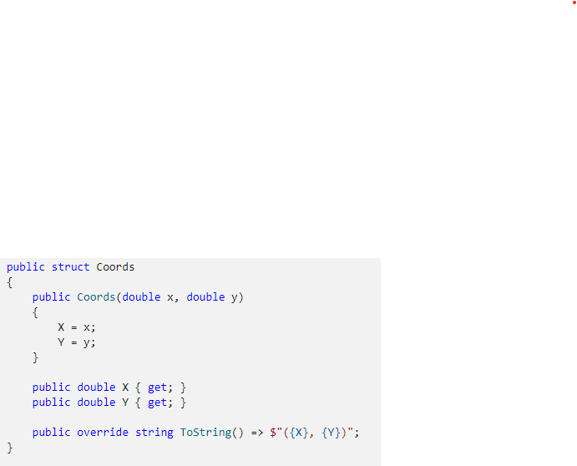
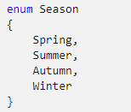
Value Types (Enums and Structs)
Enum
An enumeration type is a distinct type defined by a set named constants .
Each named constant has a underlying integral numeric type associated with it (default as int).Enum
Struct
A struct is a value type that can declare constants, fields, methods, properties, indexers, operators.
Typically used to design small data-centric types that provide little behavior

Slide 7
Reference Types
Classes
Object (System.Object)
String
User-defined classes
Interfaces
Arrays
Delegates
Represent references to methods.
Make it possible to treat methods as entities that can be assigned to variables and passed as parameters

Slide 8
Sources
https://www.javatpoint.com/csharp-data-types
https://www.tutorialsteacher.com/csharp/csharp-data-types
https://docs.microsoft.com/en-us/dotnet/csharp/fundamentals/types/
https://docs.microsoft.com/en-us/dotnet/csharp/language-reference/builtin-types/struct
https://docs.microsoft.com/en-us/dotnet/csharp/tour-of-csharp/features#delegates-and-lambda-expressions

